Slide 1
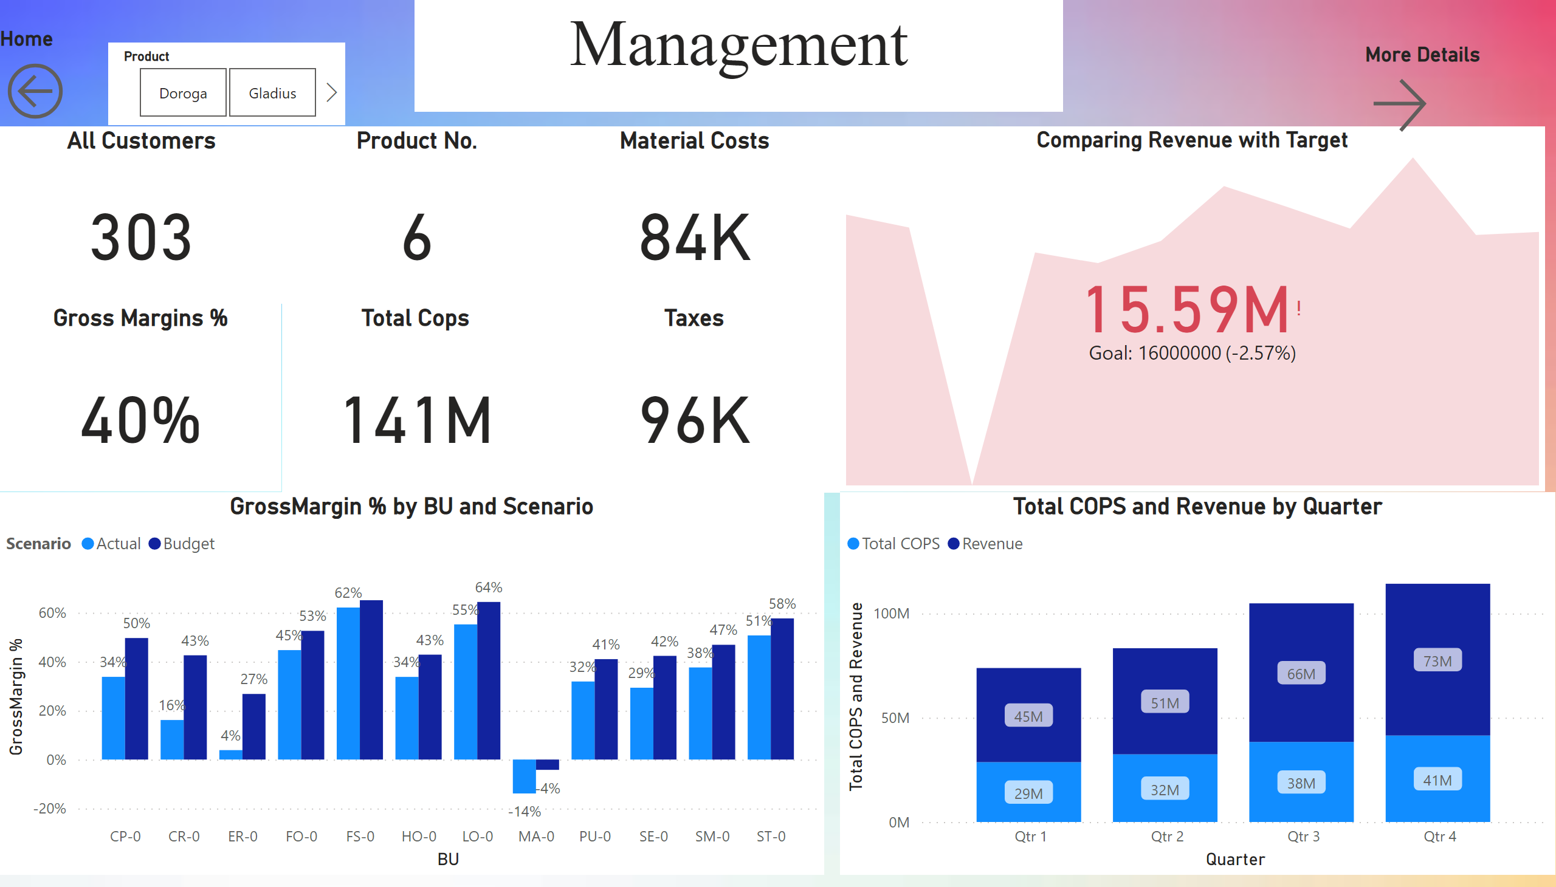
Management
Notes:
All Customers
No alt text provided
Taxes
No alt text provided
Material Costs
No alt text provided
Total Cops
No alt text provided
Gross Margins %
No alt text provided
Product No.
No alt text provided
Comparing Revenue with Target
No alt text provided
Home
No alt text provided
More Details
No alt text provided
lineStackedColumnComboChart
No alt text provided
clusteredColumnChart
No alt text provided
slicer
No alt text provided
textbox
No alt text provided

Slide 2
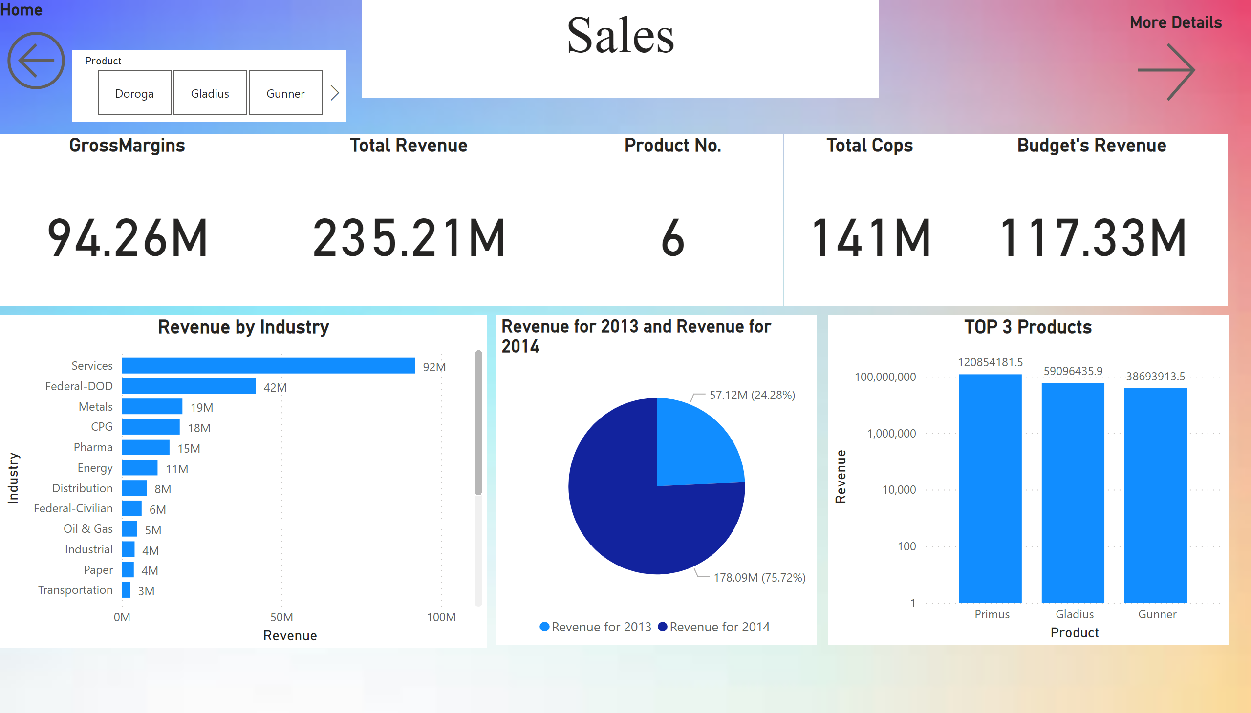
Sales
Notes:
TOP 3 Products
No alt text provided
Total Revenue
No alt text provided
GrossMargins
No alt text provided
Product No.
No alt text provided
pieChart
No alt text provided
Total Cops
No alt text provided
clusteredBarChart
No alt text provided
Home
No alt text provided
More Details
No alt text provided
slicer
No alt text provided
Budget's Revenue
No alt text provided
textbox
No alt text provided

Slide 3
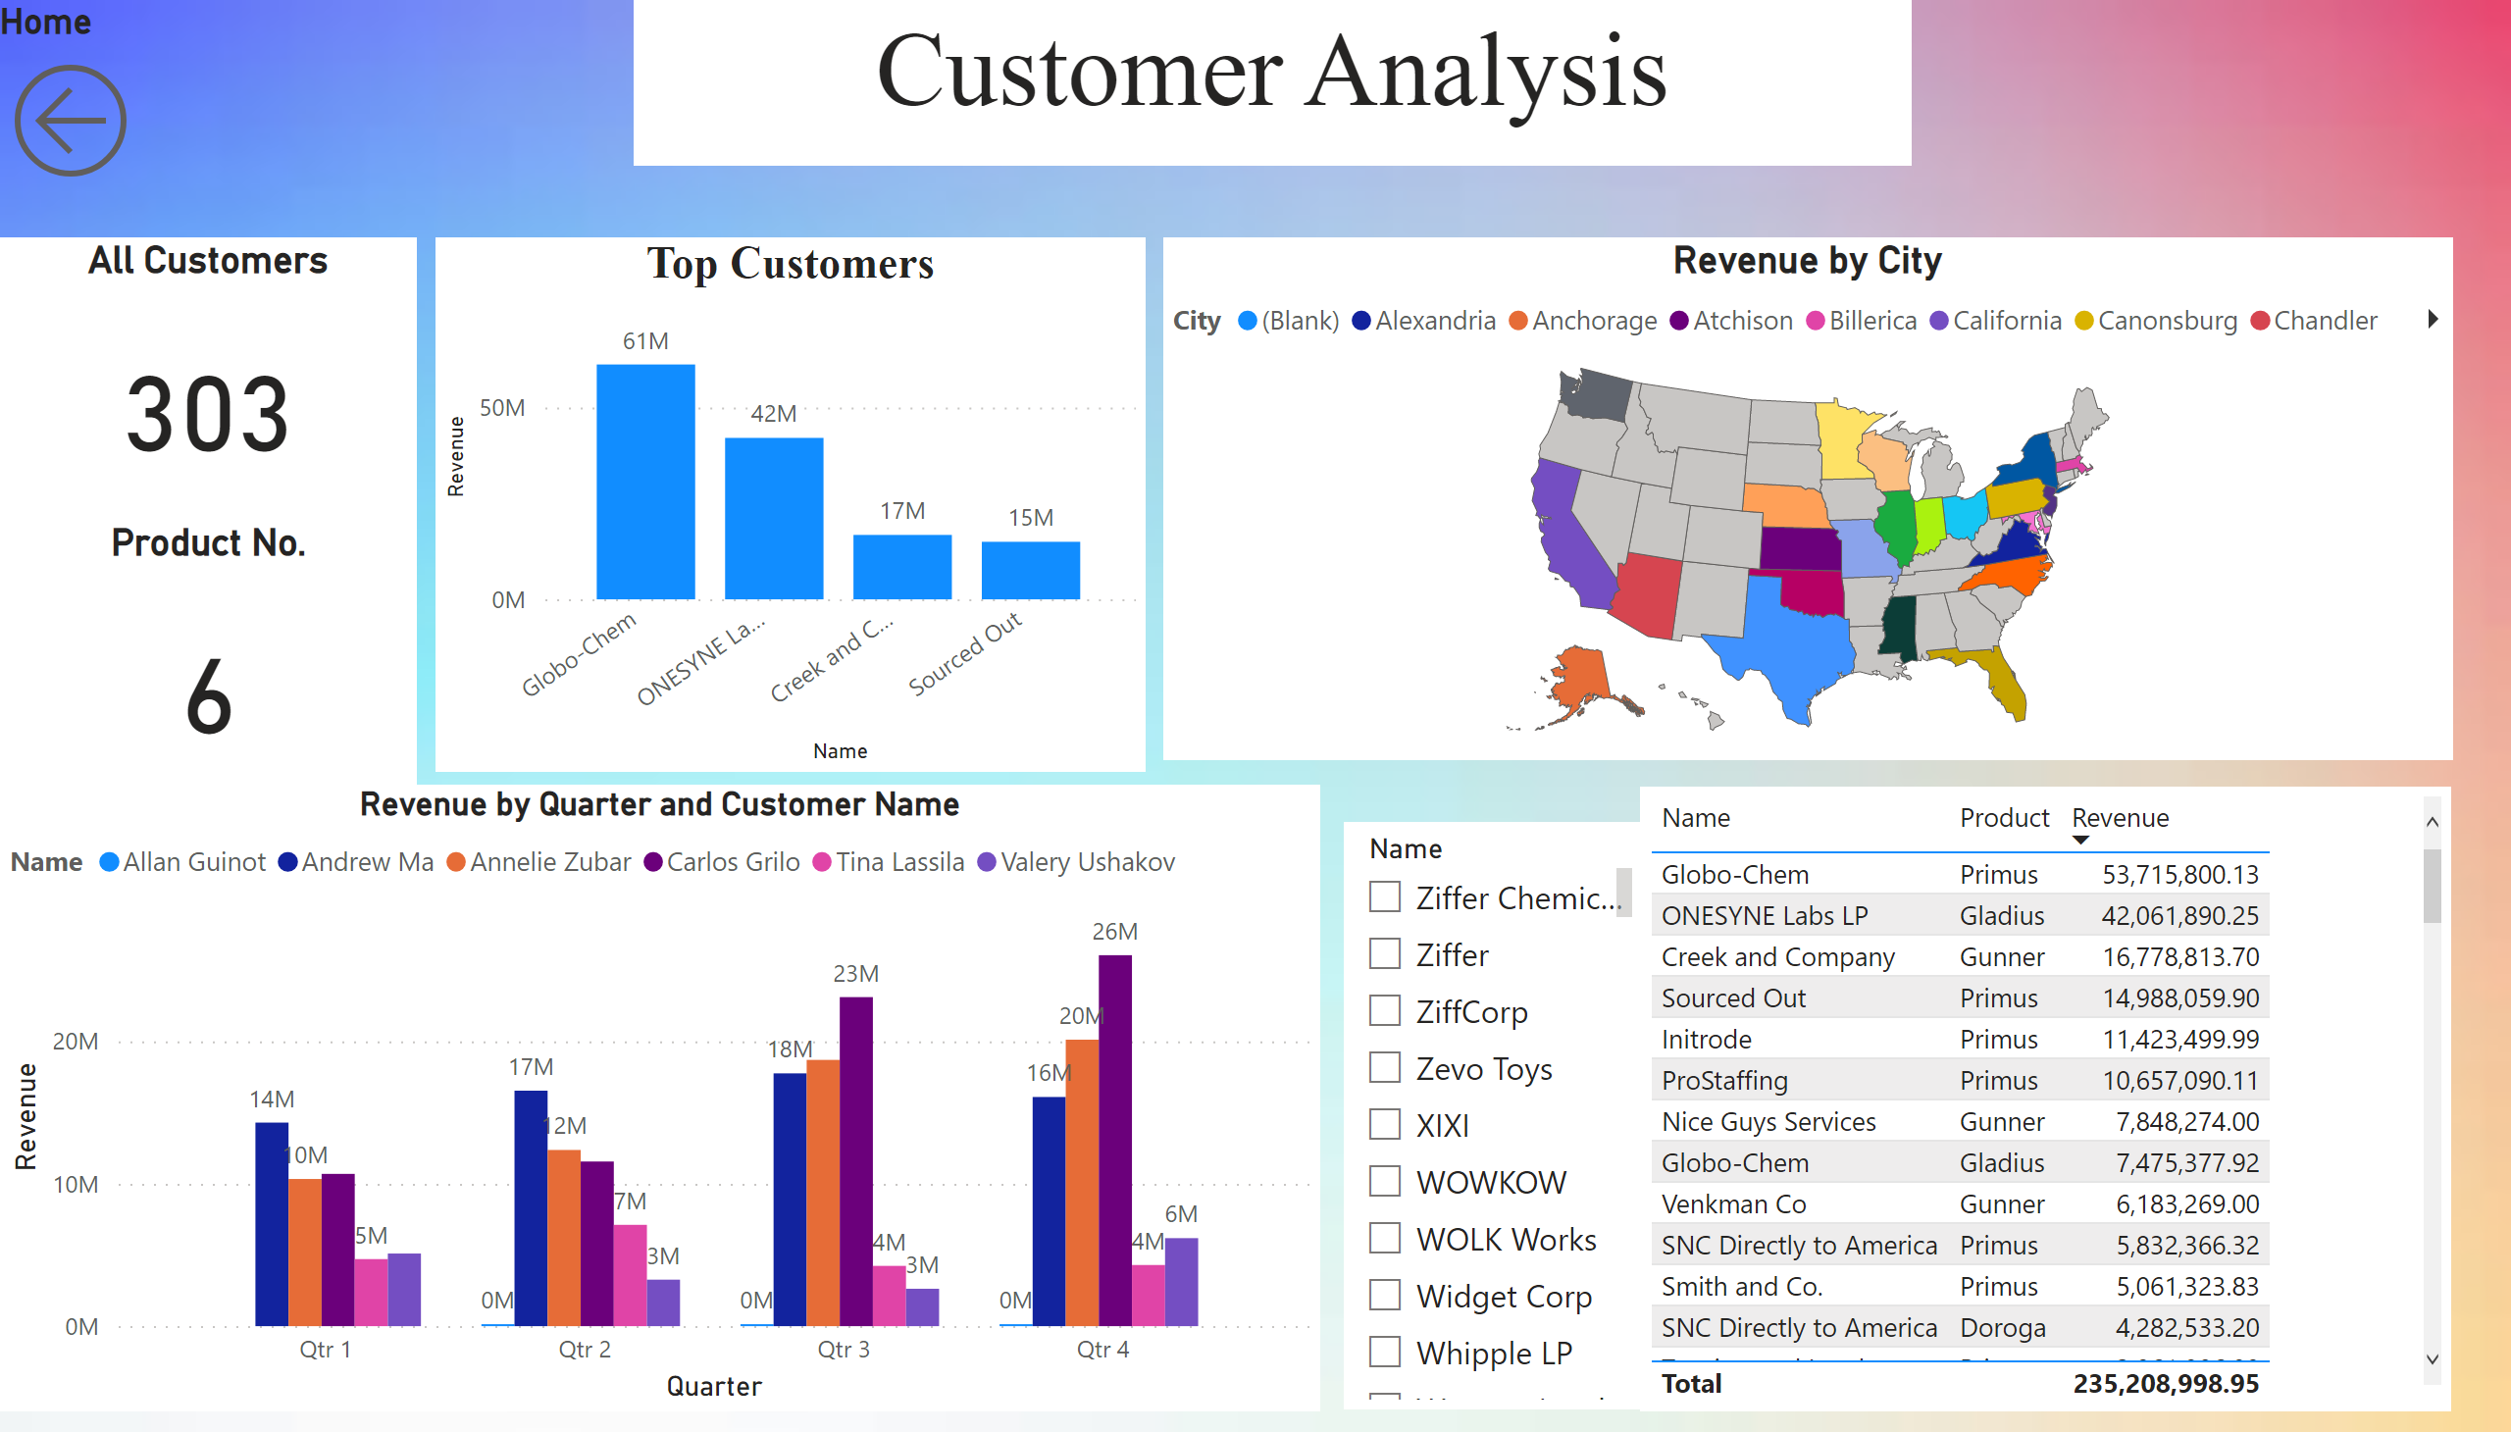
Customers
Notes:
Revenue by City
No alt text provided
All Customers
No alt text provided
Top Customers
No alt text provided
tableEx
No alt text provided
Product No.
No alt text provided
Home
No alt text provided
Revenue by Quarter and Customer Name
No alt text provided
slicer
No alt text provided
textbox
No alt text provided

Slide 4
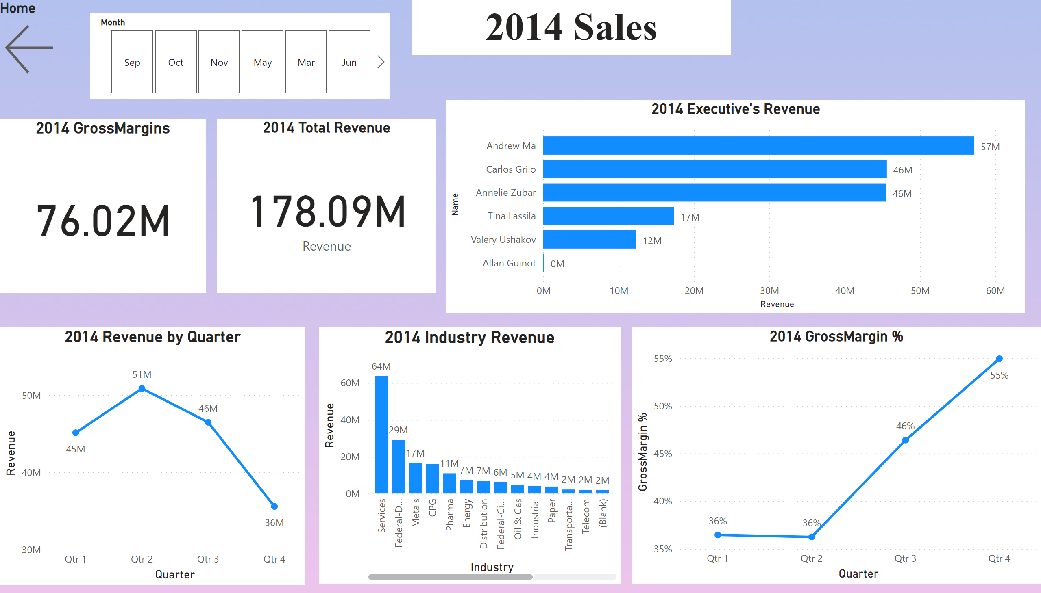
2014 Sales
Notes:
2014 GrossMargins
No alt text provided
2014 Industry Revenue
No alt text provided
2014 GrossMargin %
No alt text provided
2014 Revenue by Quarter
No alt text provided
2014 Total Revenue
No alt text provided
2014 Executive's Revenue
No alt text provided
textbox
No alt text provided
Home
No alt text provided
slicer
No alt text provided

Slide 5
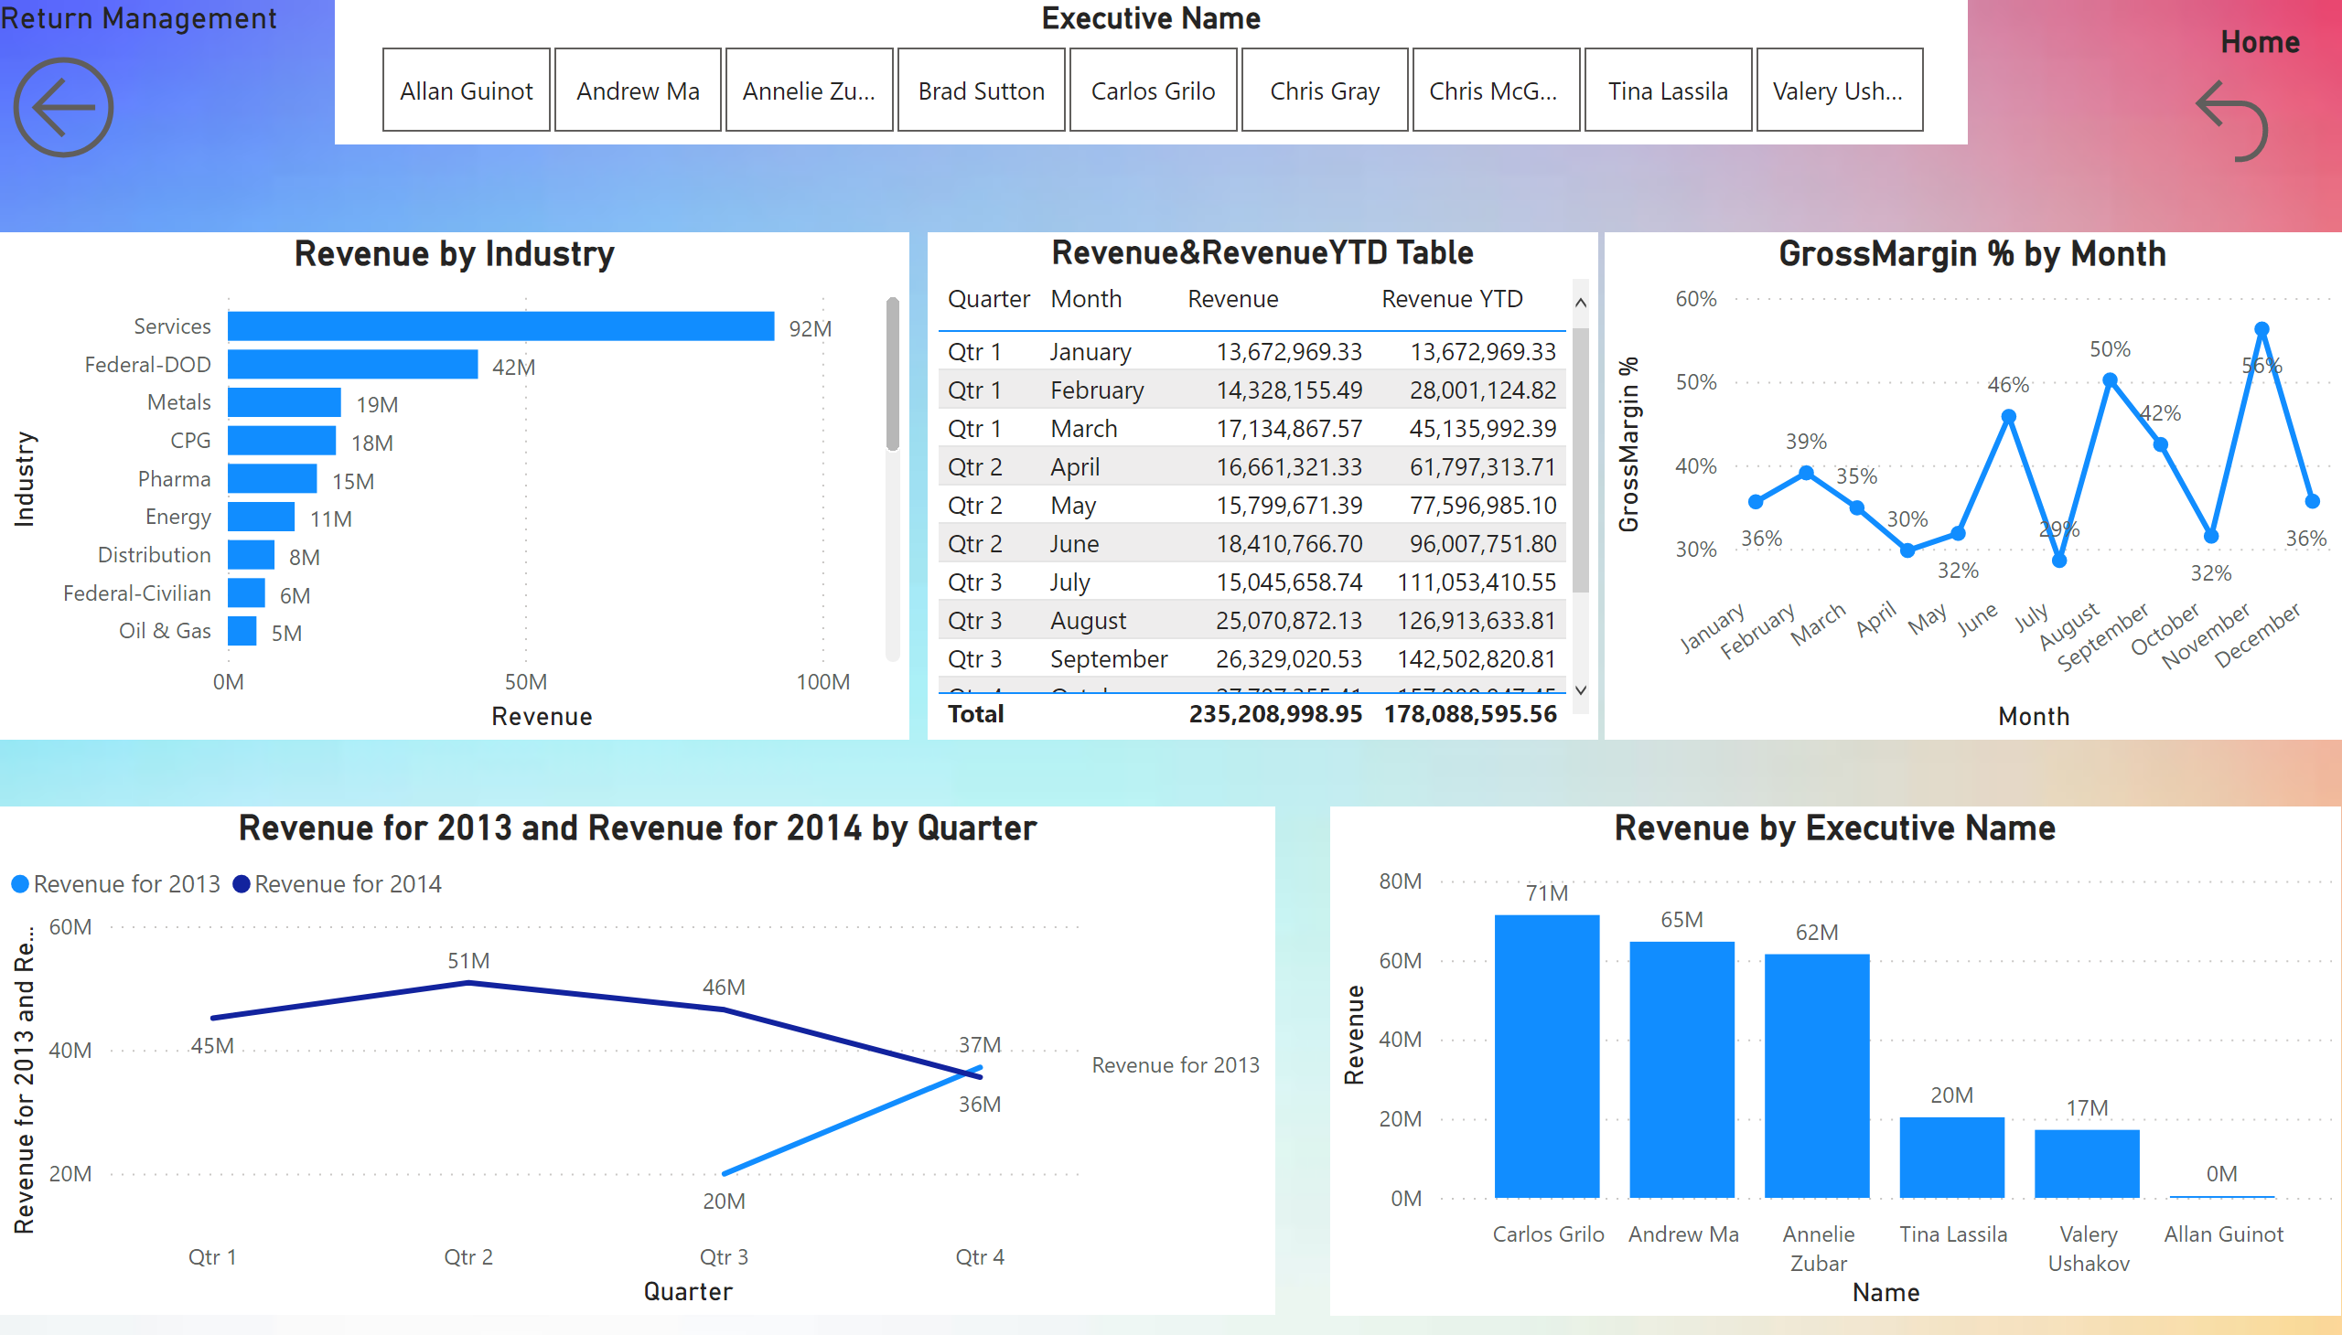
ManagementDetails
Notes:
Revenue&RevenueYTD Table
No alt text provided
clusteredBarChart
No alt text provided
Revenue by Executive Name
No alt text provided
Return Management
No alt text provided
lineChart
No alt text provided
Executive Name
No alt text provided
lineChart
No alt text provided
Home
No alt text provided

Slide 6
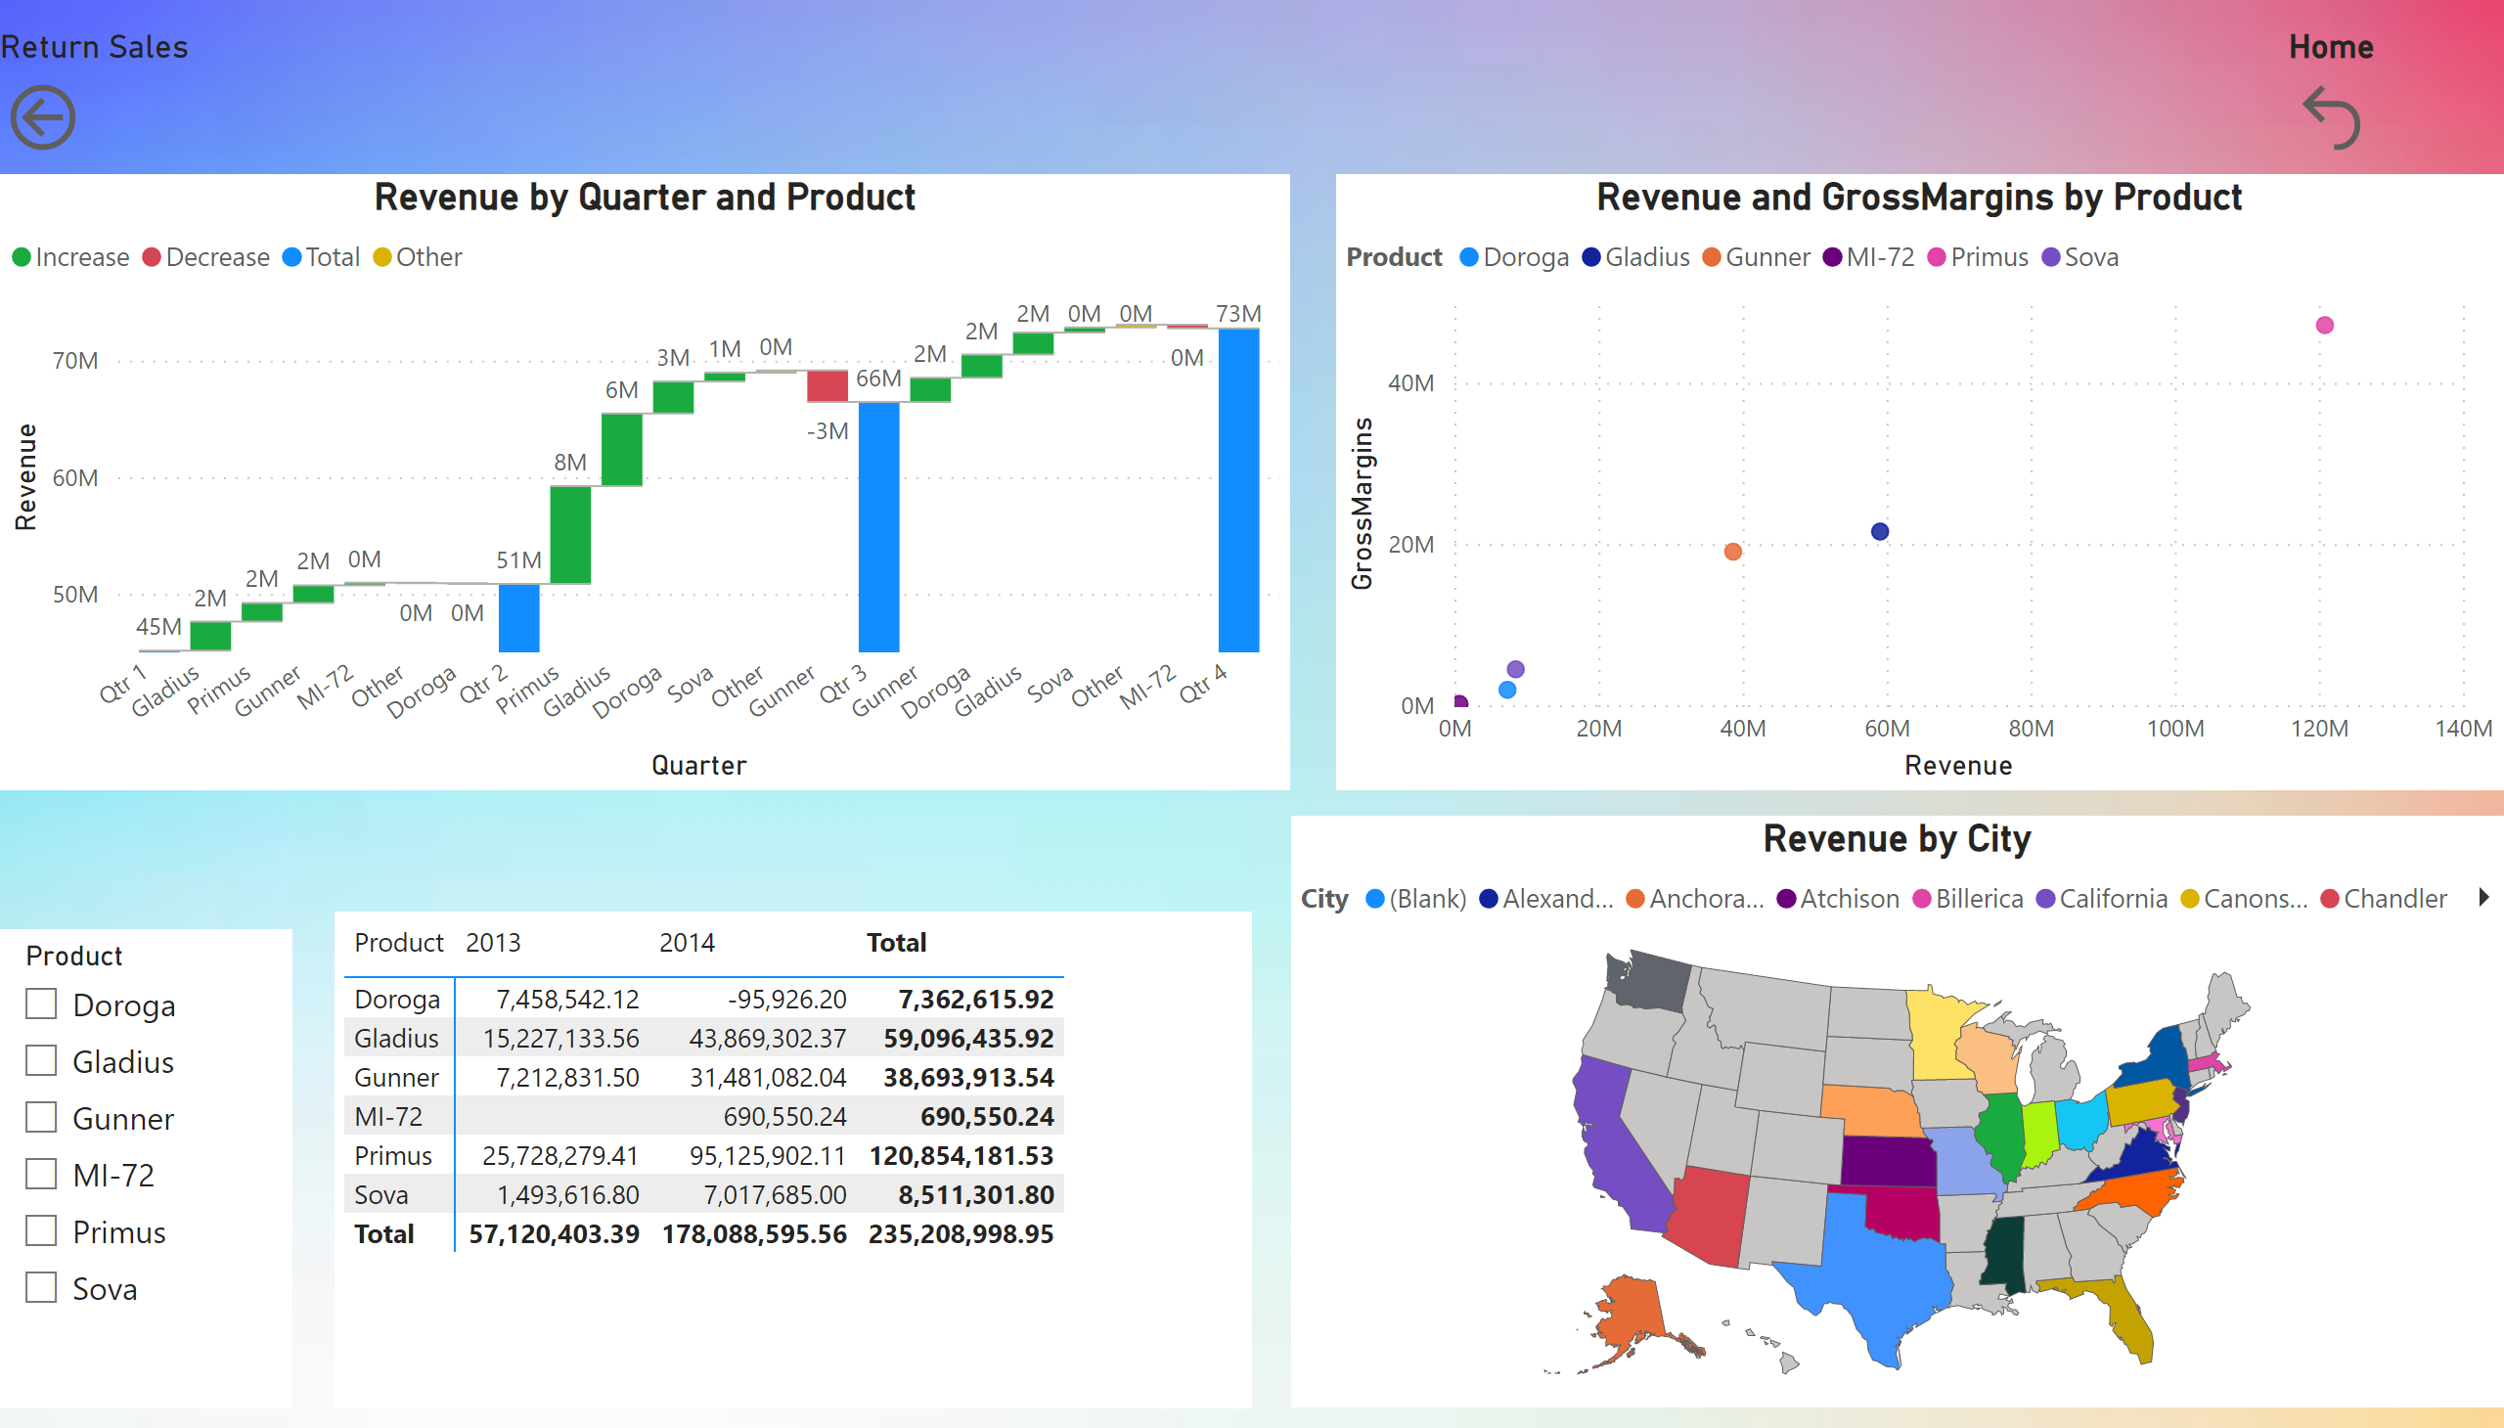
SalesDetails
Notes:
Revenue by City
No alt text provided
scatterChart
No alt text provided
pivotTable
No alt text provided
slicer
No alt text provided
Return Sales
No alt text provided
waterfallChart
No alt text provided
Home
No alt text provided

